Slide 1
EMPLOYEe ADMINISTRATION SYSTEM
Presented By:-
Supriya Sonawane (Roll no. 229101)
Komal Dekate (Roll no. 229117)
Guided By:-Mrs.Geeta Darunte

Slide 2
What is Employee Administration System?
Employee Administration System is a distributed application, developed to maintain the details of employee working in any organization.
The EAS has been developed to override the problems prevailing in the practicing manual system.
It maintains the information about the personal and official details of the employees.

Slide 3
OBJECTIVES OF OUR PROJECT
This project aims to simplify the task of maintaining records of the employees of company.
To develop an well-designed database to store employee information.
Provides full functional reports to Administration of company.
The objective of this project is to provide a comprehensive approach towards the administration of employee information.

Slide 4
EXISTING SYSTEM
The records are maintained in registers.
Time consuming process.
Complicated searching, editing and updating.

Slide 5
PROPOSED SYSTEM
Helps in maintaining the computerized employee details.
Add salary details and generate salary report.
Easy calculation of various leaves in categories.
Add new user to the system accordingly.
Generate feedback form for the employee.

Slide 6
SOFTWARE DESIGN
Frontend :- React JS
Backend:- Spring Boot
Database:- MySQL

Slide 7
SYSTEM REQUIREMENT
Software Requirement
OS: Windows 8.1
IDE: VS Code, STS
Database: MySQL
Server: Apache
Hardware Requirements
Processor: Intel Dual Core
RAM: Minimum 4 GB
Hard Disk Drive :Minimum 500GB Disk Space

Slide 8
MODULES
Admin
Employee
Leave
Salary
Logout
User
Leave
Salary
Employee Account
Feedback
Logout

Slide 9
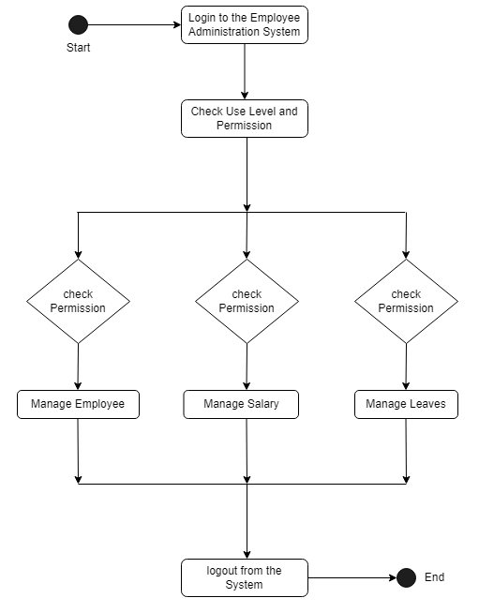
ACTIVITY DIAGRAM

Slide 10
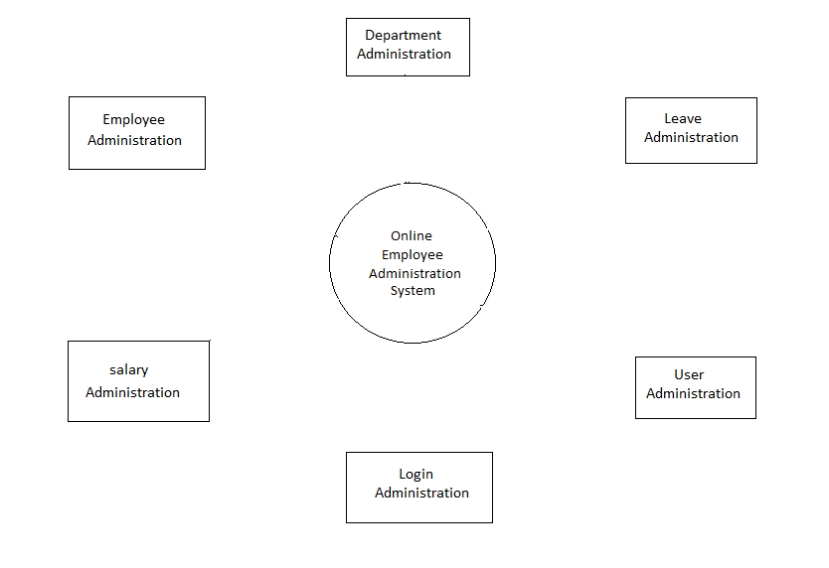
Zero Level DFD

Slide 11
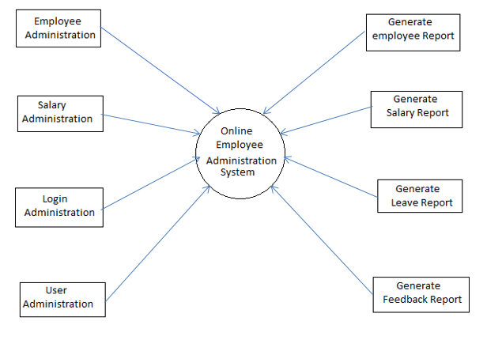
First Level DFD Diagram

Slide 12
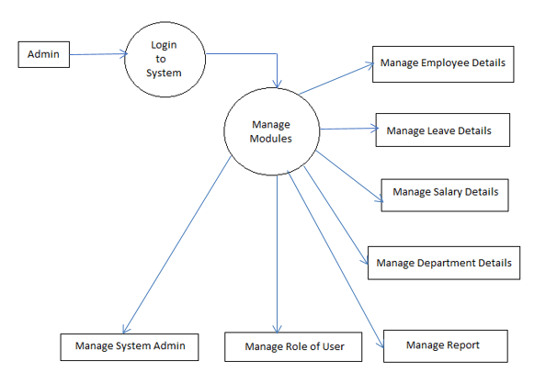
Second Level Diagram

Slide 13
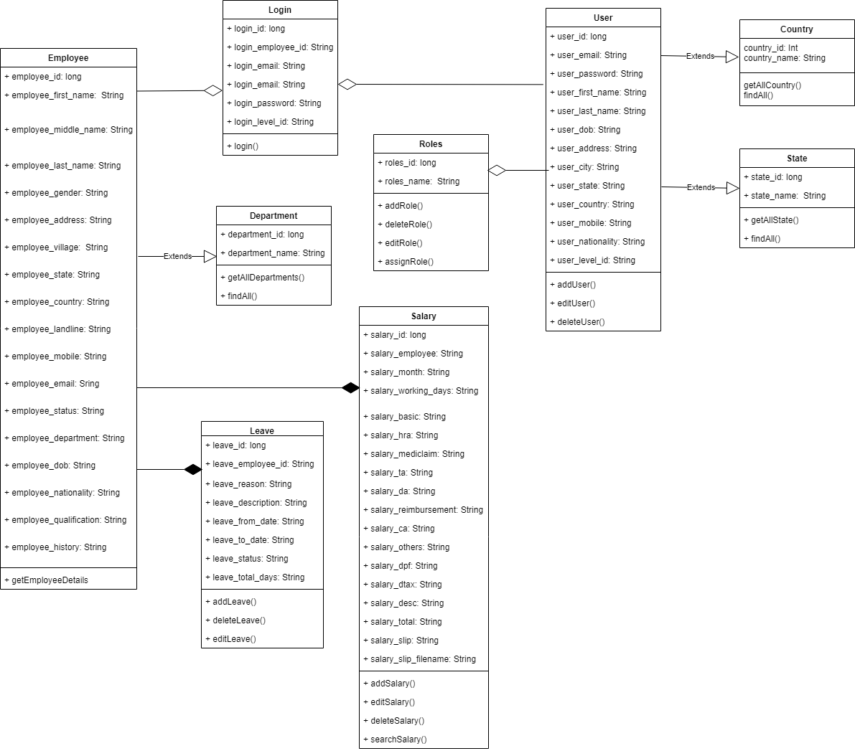
Class Diagram

Slide 14
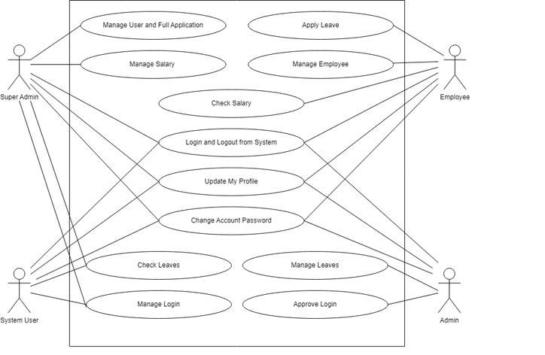
UseCase Diagram

Slide 15
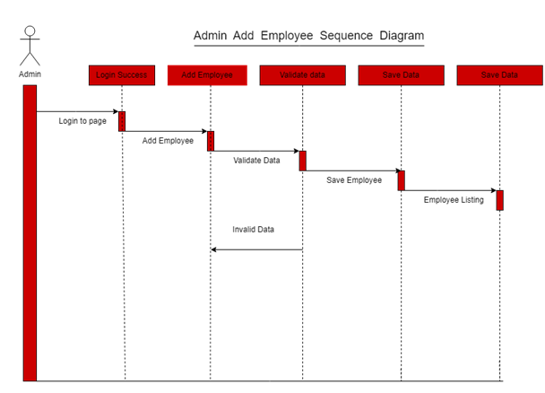
Add Employee Sequence Diagram

Slide 16
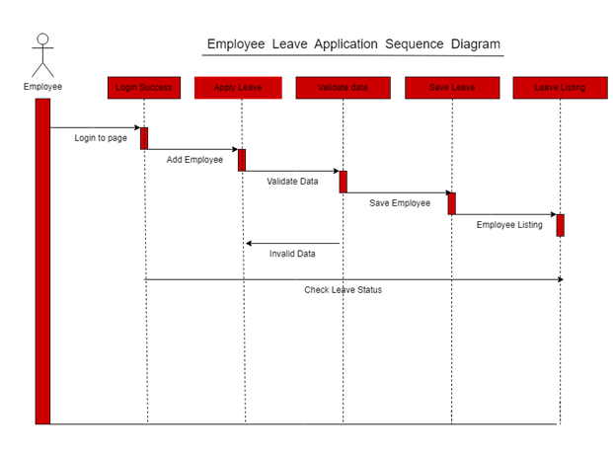
Employee Leave Application Sequence Diagram

Slide 17
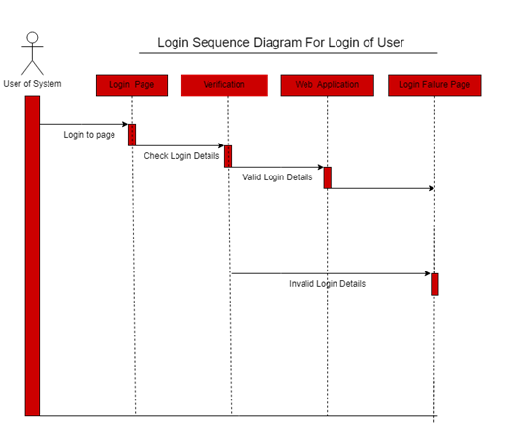
Login of User Sequence Diagram

Slide 18
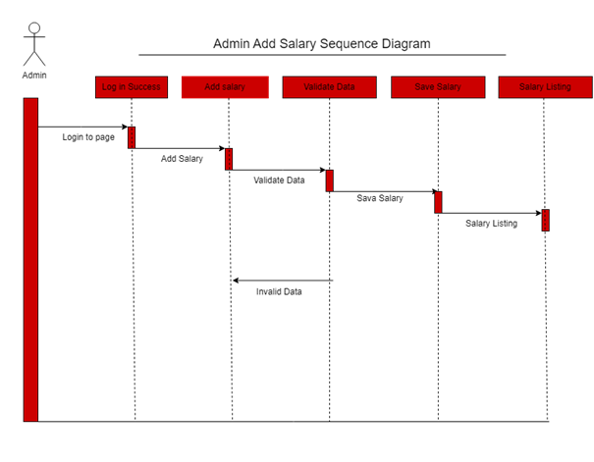
Add Salary Sequence Diagram

Slide 19
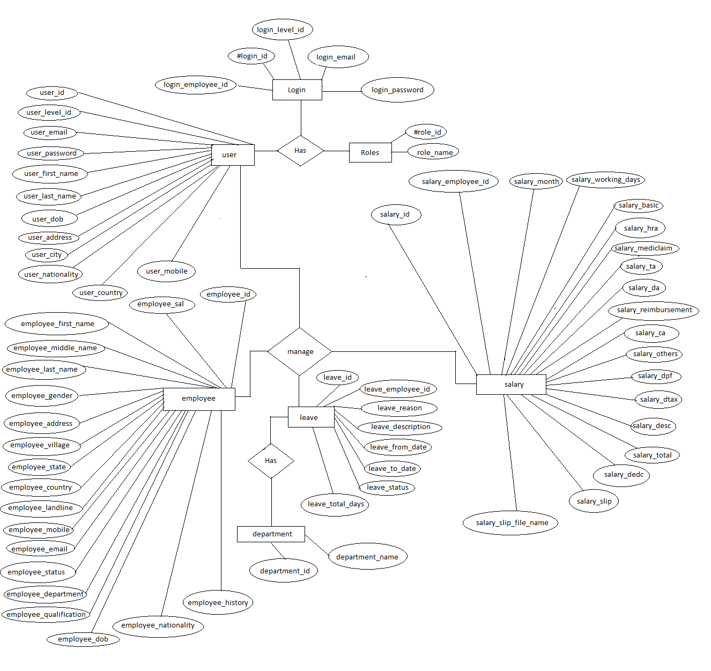
ER DIAGRAM

Slide 20
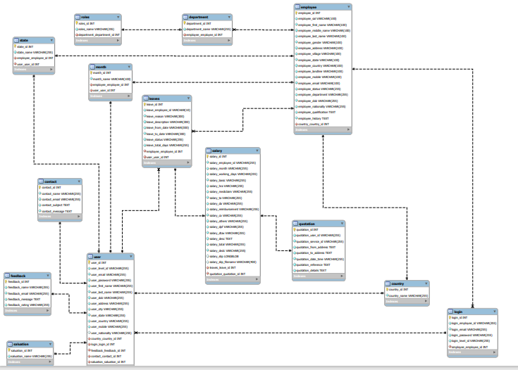
SYSTEM GENERATED ER DIAGRAMS

Slide 21
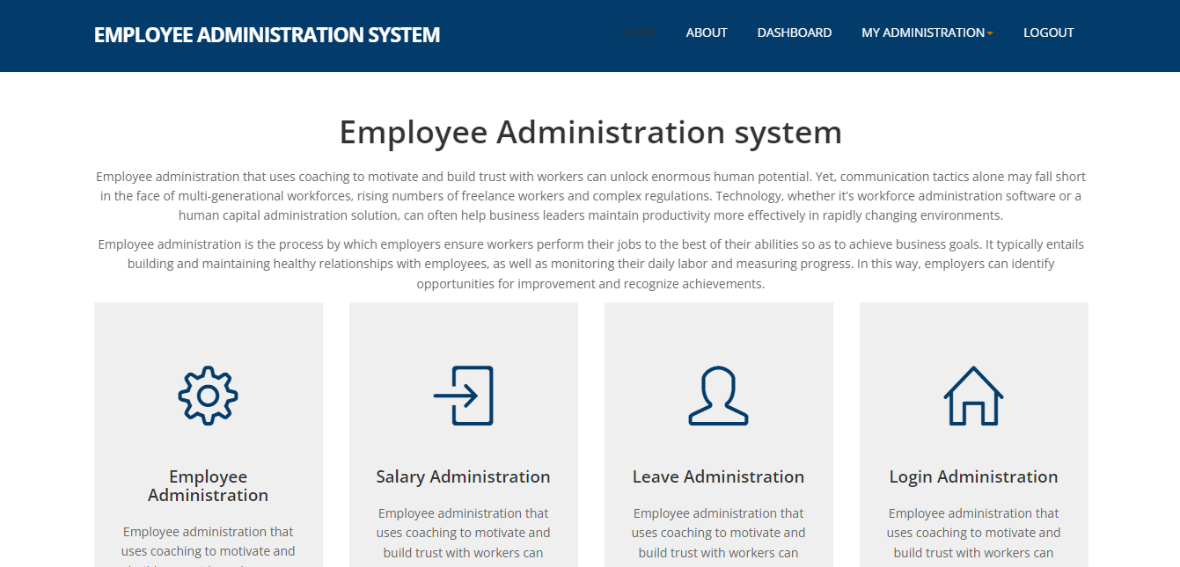
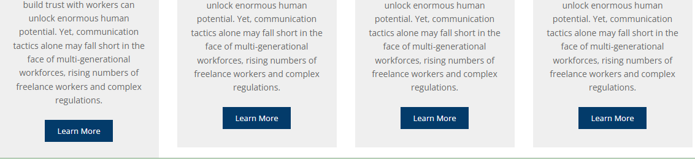
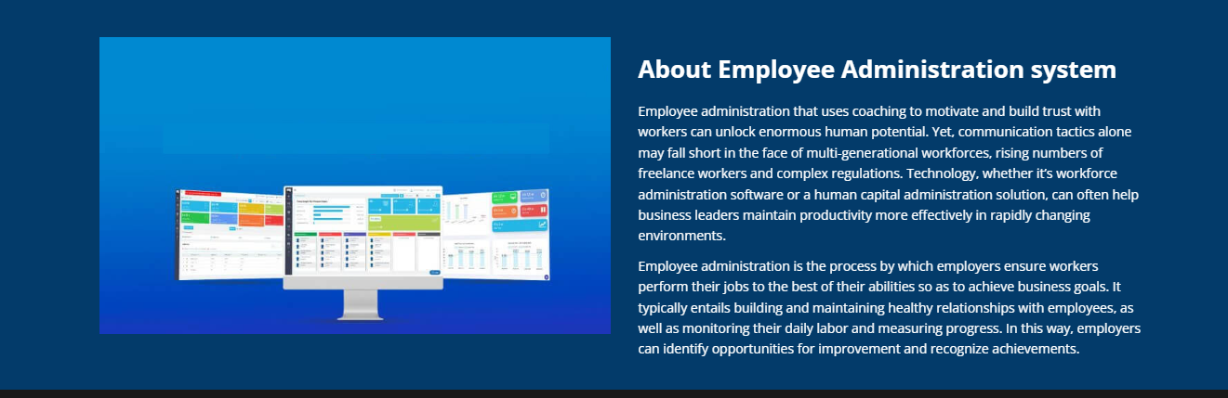
PROJECT SCREENSHOTS

Slide 22
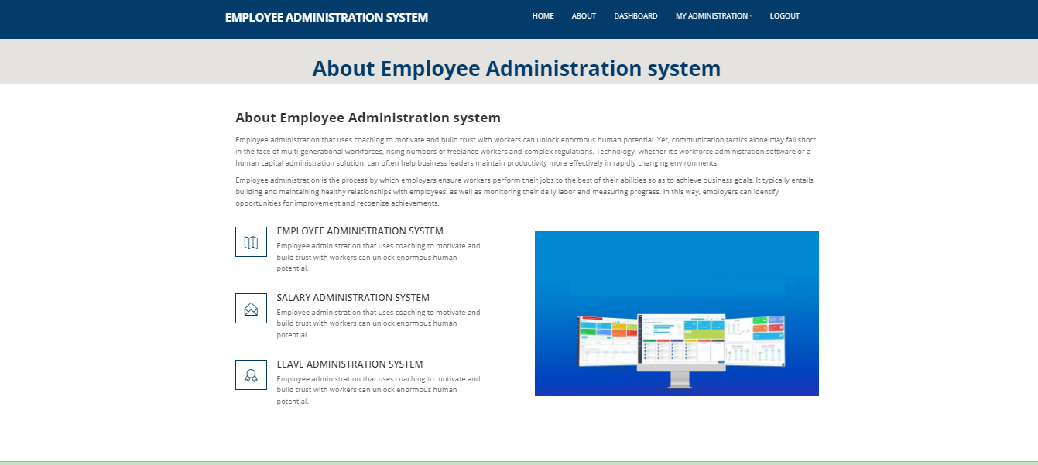
About Page

Slide 23
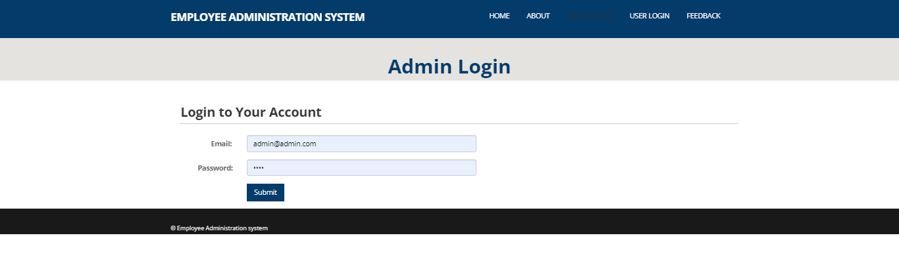
Admin Login

Slide 24
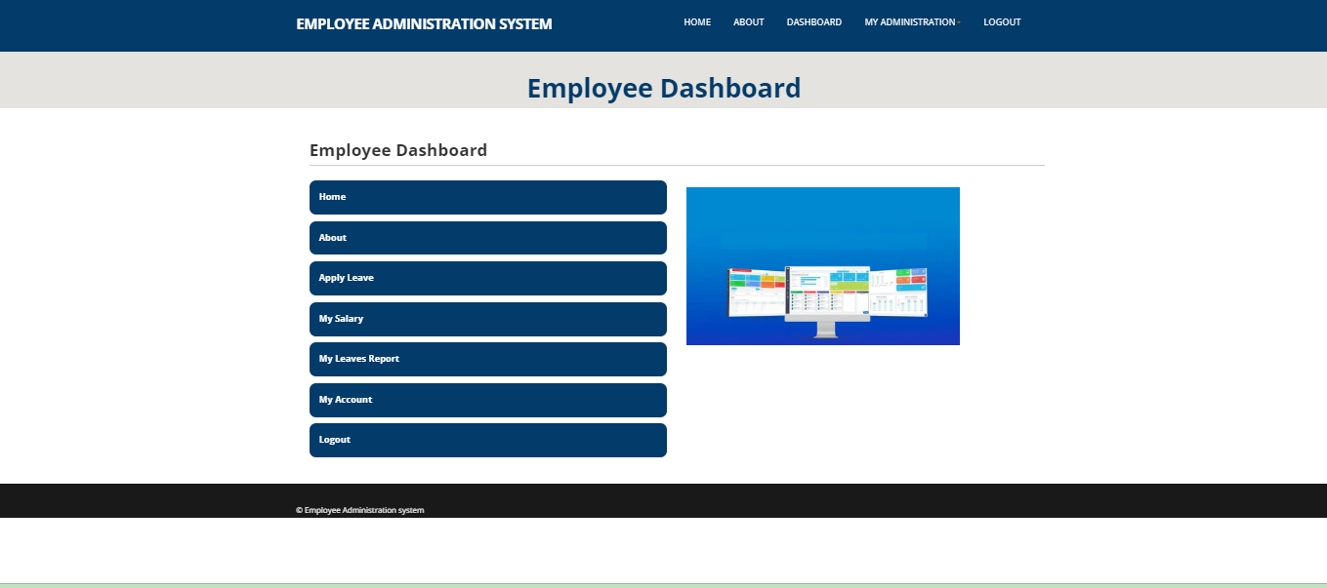
Employee Dashboard

Slide 25
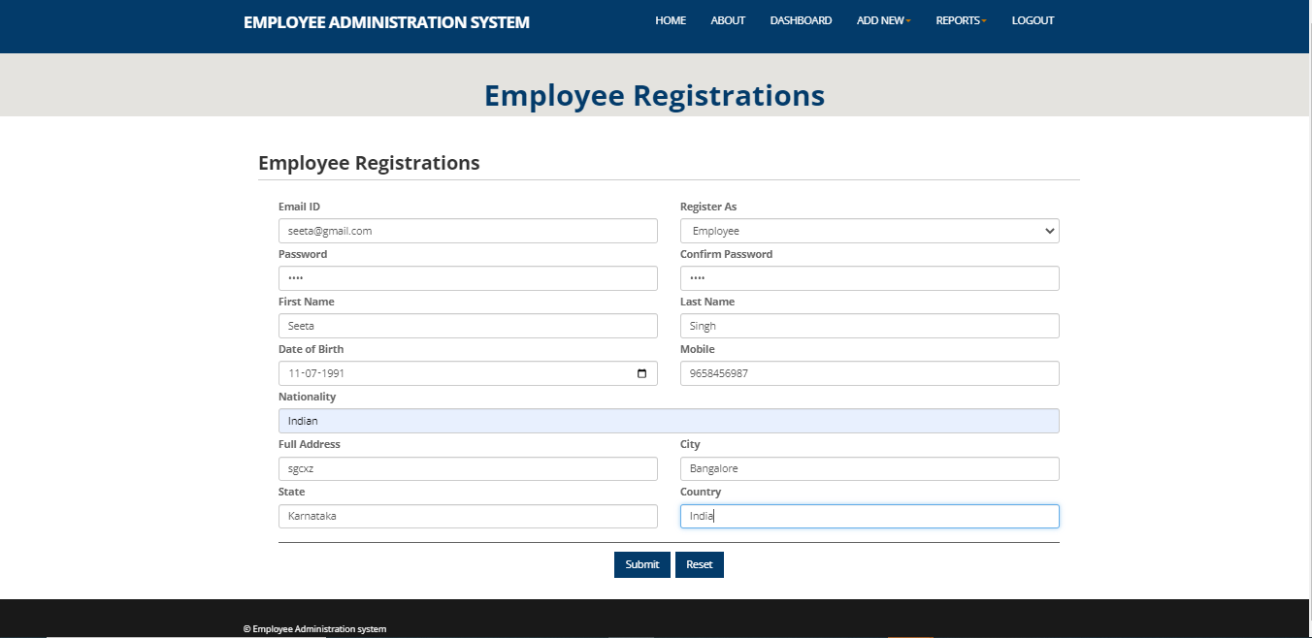
Add Employee

Slide 26
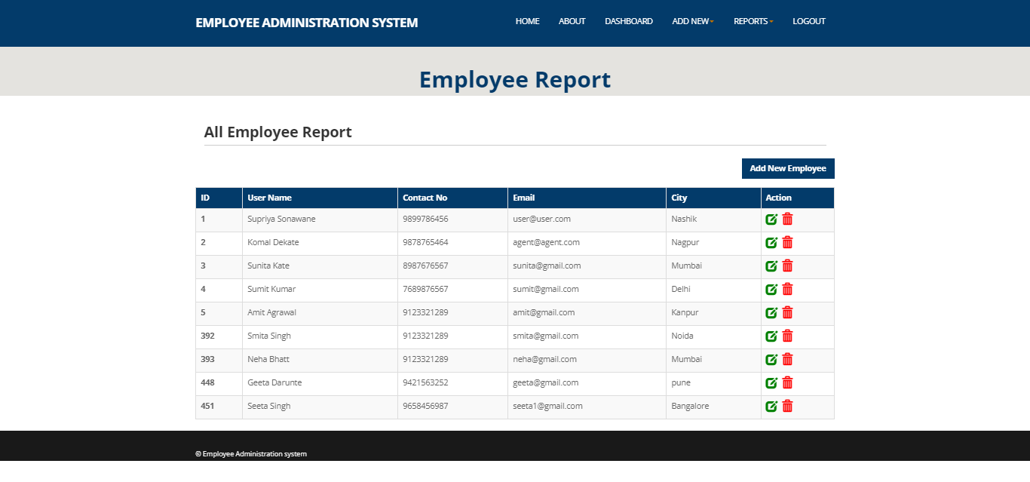
All Employee Report

Slide 27
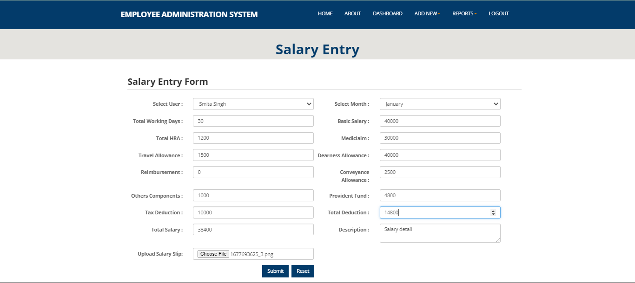
Add Salary of Employee

Slide 28
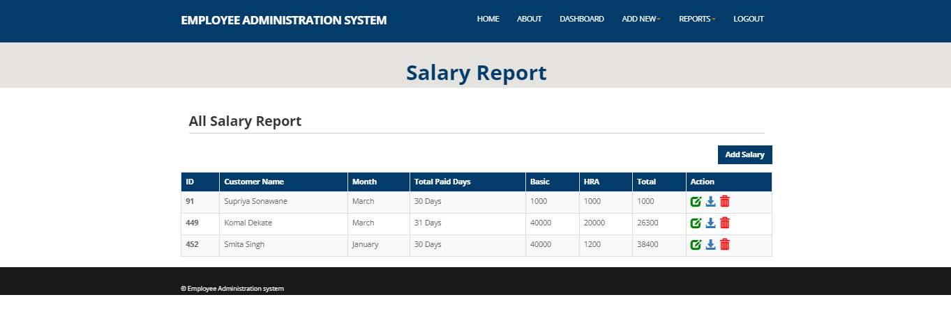
Salary Report of Employee

Slide 29
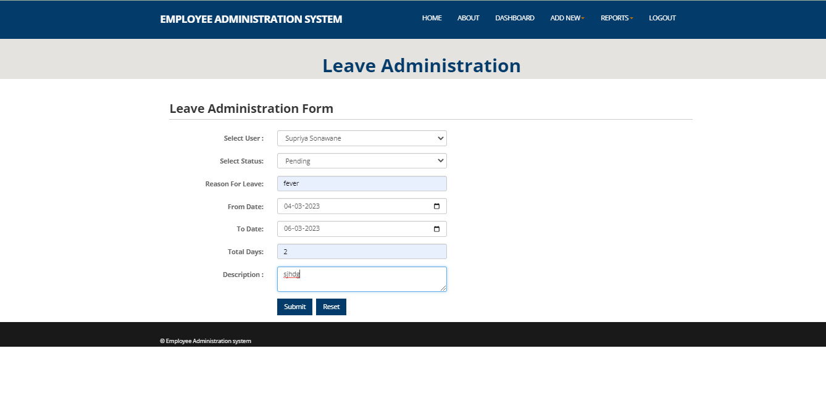
Leave Administration of Employee

Slide 30
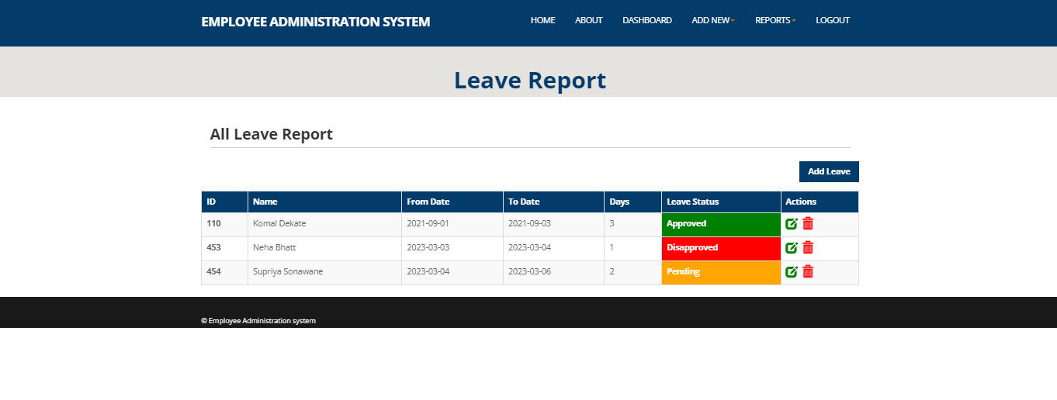
Leave Report of Employee

Slide 31
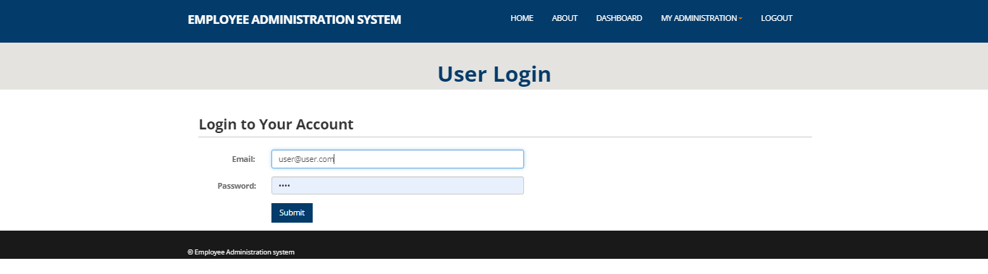
User Login

Slide 32
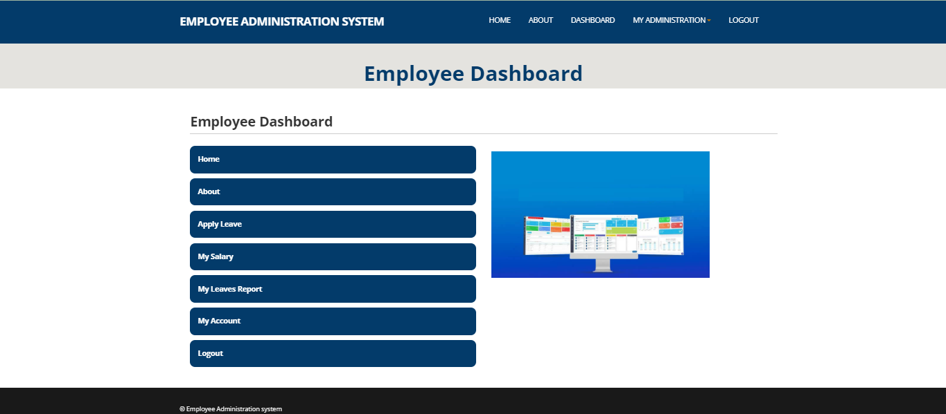
Employee Dashboard

Slide 33
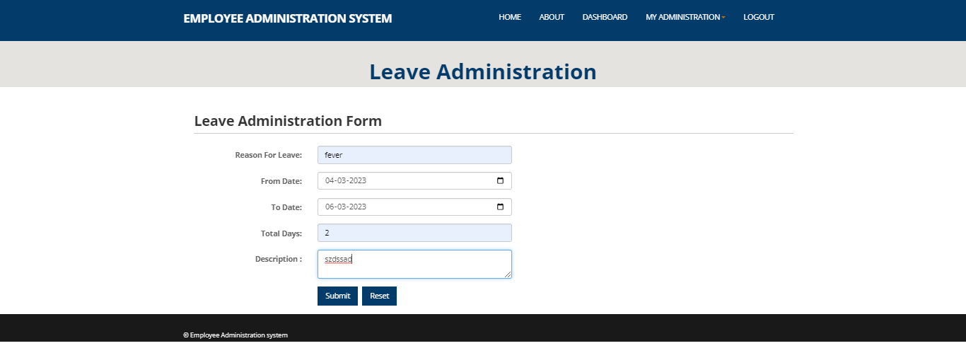
Apply for Leave

Slide 34
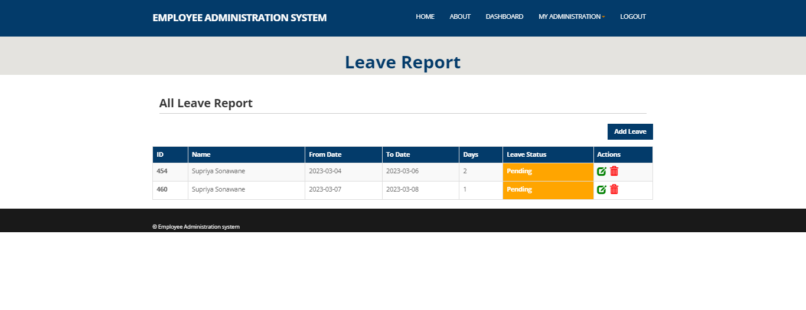
Leave Report of Employee

Slide 35
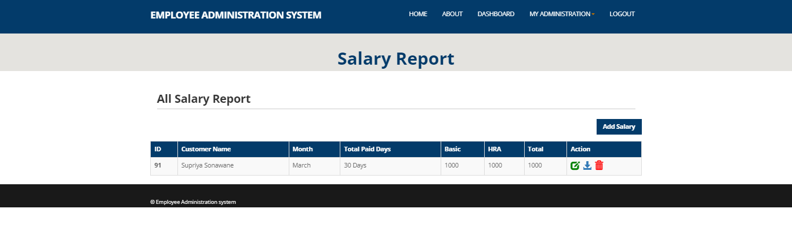
Salary Report of Employee

Slide 36
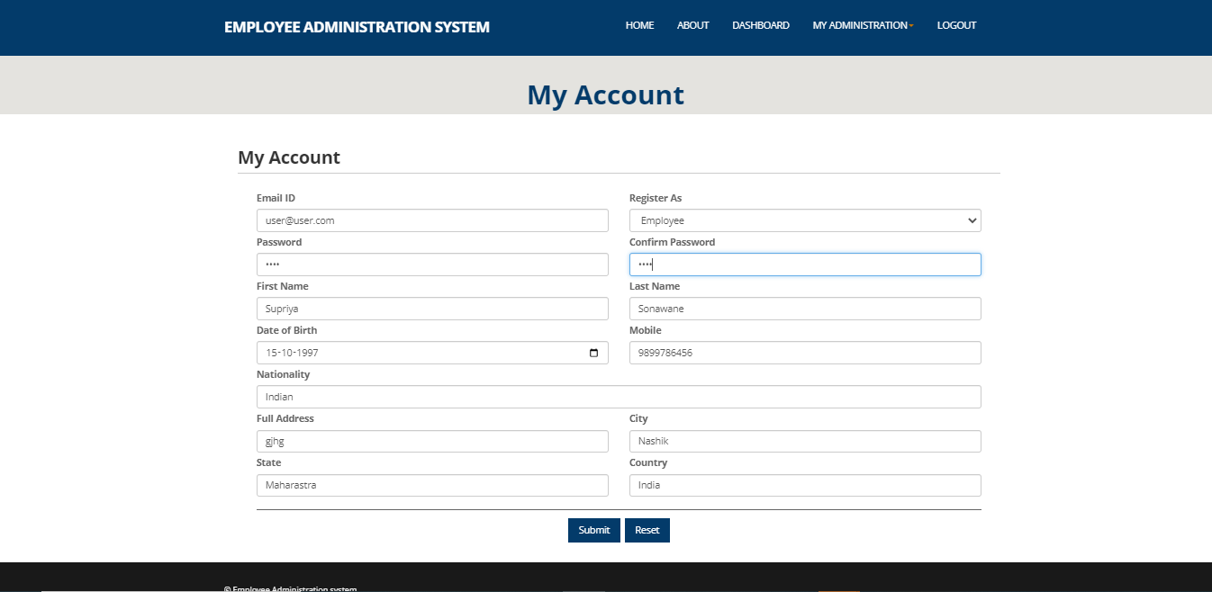
Update Employee Account

Slide 37
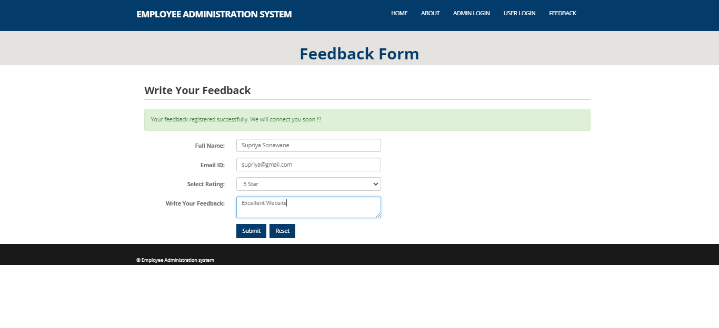
Employee Feedback Form

Slide 38
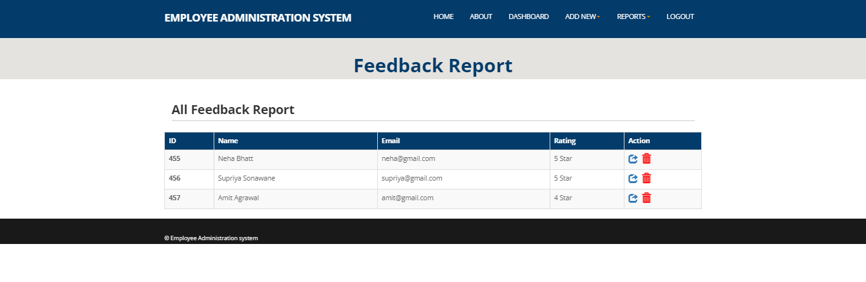
Feedback Report

Slide 39
ADVANTAGES
Provide computerized system for maintaining records.
More efficient and reliable.
Less time consuming and easy to use.
Huge data storage with less computer memory.
Avoid Human errors and efforts for Maintaining daily data.
Avoid Data manipulations.
Also avoids Data inconsistency and redundancy.

Slide 40
FUTURE SCOPE
Automatic salary deduction as per the leave taken by employees.
Attendance of employee can be added in the EAS system.
SMS and Email facility to employee as salary credited can be future added in the EAS system

Slide 41
CONCLUSION
Future recommendations for the extension and improvement of the system have discussed.
The software product produced was fairly good, it achieved most of the user requirements, the employee interface is good and easy to navigate.
The Admin side validation is Excellent
as well as assessment of achieved functionality.

Slide 42
Thank you....

